Slide 1
Chapter 10: Application Layer
Instructor Materials
CCNA Routing and Switching
Introduction to Networks v6.0
Notes:
Cisco Networking Academy Program
Introduction to Networks
Chapter 10: Application Layer

Slide 2
Instructor Materials – Chapter 10 Planning Guide
This PowerPoint deck is divided in two parts:
Instructor Planning Guide
Information to help you become familiar with the chapter
Teaching aids
Instructor Class Presentation
Optional slides that you can use in the classroom
Begins on slide # 12
Note: Remove the Planning Guide from this presentation before sharing with anyone.
Notes:
2

Slide 3
Chapter 10: Application Layer
Introduction to Networks 6.0 Planning Guide
Notes:
Cisco Networking Academy Program
Introduction to Networks v6.0
Chapter 10: Application Layer

Slide 4
Chapter 10: Activities
What activities are associated with this chapter?
Page # | Activity Type | Activity Name | Optional?
10.0.1.2 | Class Activity | Application Investigation | Optional
10.1.1.4 | Interactive Activity | Application and Presentation (Protocols and Standards) | Recommended
10.1.2.5 | Lab | Researching Peer-To-Peer File Sharing | Optional
10.2.1.7 | Packet Tracer | Web and Email | Optional
10.2.2.4 | Syntax Checker | DNS CLI Commands in Windows and Linux | Recommended
10.2.2.7 | Packet Tracer | DHCP and DNS Servers | Optional
10.2.2.8 | Lab | Observing DNS Resolution | Recommended
10.2.3.3 | Packet Tracer | FTP | Optional
10.2.3.4 | Lab | Exploring FTP | Recommended
The password used in the Packet Tracer activities in this chapter is: PT_ccna5
Notes:
4

Slide 5
Chapter 10: Activities (Cont.)
What activities are associated with this chapter?
Page # | Activity Type | Activity Name | Optional?
10.3.1.1 | Class Activity | Make It Happen! | Optional
10.3.1.2 | Packet Tracer | Explore a Network | Optional
10.3.1.3 | Packet Tracer Multiuser | Tutorial | Optional
10.3.1.4 | Packet Tracer Multiuser | Implement Services | Optional
The password used in the Packet Tracer activities in this chapter is: PT_ccna5
Notes:
5

Slide 6
Chapter 10: Assessment
Students should complete Chapter 10, “Assessment” after completing Chapter 10.
Quizzes, labs, Packet Tracers and other activities can be used to informally assess student progress.
Notes:
6

Slide 7
Chapter 10: Best Practices
Prior to teaching Chapter 10, the instructor should:
Complete Chapter 10, “Assessment.”
The objectives of this chapter are:
Explain how the functions of the application layer, session layer, and presentation layer work together to provide network services to end user applications.
Explain how common application layer protocols interact with end user applications.
Explain how web and email protocols operate.
Explain how DNS and DHCP operate.
Explain how file transfer protocols operate.
Notes:
7

Slide 8
Chapter 10: Best Practices (Cont.)
The Application layer is where data enters the data network. Introduce by discussing well-known internet/network applications. Examples include web-browsers, email, Telnet, etc.
Explain to students that an understanding of services and protocols is crucial because network traffic can be manipulated based on the service and corresponding protocol used. Therefore, differing types of network traffic can be identified by the protocol used to transport the traffic.
In peer-to-peer networking, each computer can be either a client or a server. Because each device can perform both tasks, they are called peers.
Ensure that students do not confuse peer-to-peer networking with peer-to-peer applications, such as Gnutella or BitTorrent.
Peer-to-peer applications allow users to directly share specified file types across peer-to-peer or client/server networks.
Notes:
8

Slide 9
Chapter 10: Best Practices (Cont.)
Explain that the job of DNS is to make human interaction with the network easier by converting the URLs we use with application software into the IP addresses the data network uses.
Use Wireshark to capture a packet stream to a popular website. Point out the DNS request for an IP address to the website URL and the reply with the IP address.
Discuss the three email protocols and explain the differences between POP and IMAP:
Using IMAP - copies of the messages are downloaded to the client application. The original messages are kept on the server until manually deleted.
Explain that the job of DHCP is to make human interaction with the network easier by enabling users to automatically obtain IP addresses for their computers:
When a computer configured to use DCHP is turned on, it sends a DHCP request to get an IP address. Any available DHCP server then responds with an IP address (along with other IP configuration information).
DHCP Protocol – “DORA”– Discover, Offer, Request, Acknowledge.
Notes:
9

Slide 10
Chapter 10: Additional Help
For additional help with teaching strategies, including lesson plans, analogies for difficult concepts, and discussion topics, visit the CCNA Community at: https://www.netacad.com/group/communities/community-home
Best practices from around the world for teaching CCNA Routing and Switching. https://www.netacad.com/group/communities/ccna
If you have lesson plans or resources that you would like to share, upload them to the CCNA Community in order to help other instructors.
Students can enroll in Introduction to Packet Tracer (self-paced)
Notes:
10

Slide 12
Chapter 10: Application Layer
Curriculum Title
Introduction to Networks v6.0
Notes:
Cisco Networking Academy Program
Introduction to Networks v6.0
Chapter 10: Application Layer

Slide 13
Chapter 10 - Sections & Objectives
10.1 Application Layer Protocols
Explain the operation of the application layer in providing support to end-user applications.
Explain how the functions of the application layer, session layer, and presentation layer work together to provide network services to end user applications
Explain how common application layer protocols interact with end user applications.
10.2 Well-Known Application Protocols and Services
Explain how well-known TCP/IP application layer protocols operate.
Explain how web and email protocols operate.
Explain how DNS and DHCP operate.
Explain how file transfer protocols operate.
Notes:
13
Cisco Networking Academy Program
Introduction to Networks v6.0
Chapter 10: Application Layer

Slide 14
10.1 Application Layer Protocols
Notes:
10 – Application Layer
10.1 Application Layer Protocols

Slide 15
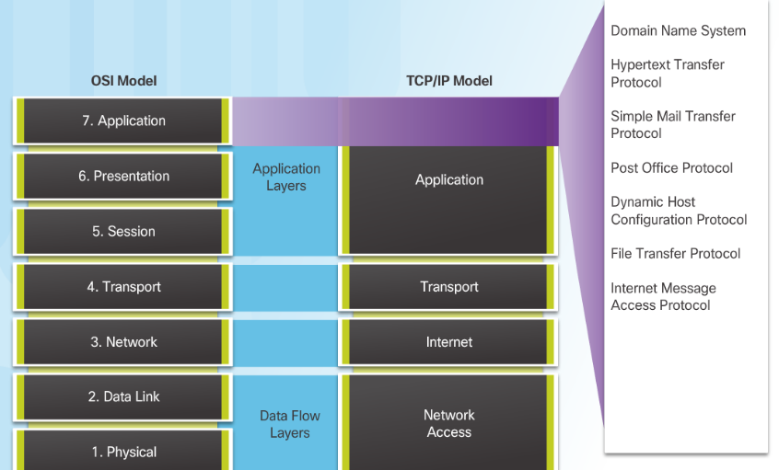
Application, Presentation, and Sessio Application Layer
Application Layer:
Closest to the end user.
Used to exchange data between programs running on the source and destination hosts.
Notes:
10.1 – Application Layer Protocols
10.1.1 – Application, Presentation, and Session
10.1.1.1– Application Layer

Slide 16
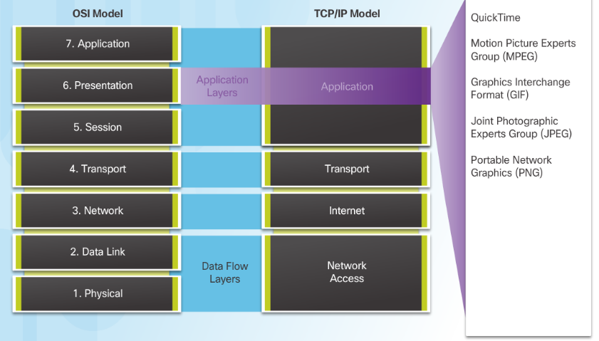
Application, Presentation, and Session Presentation and Session Layer
Presentation Layer function:
Formatting data at the source device into a compatible form for the receiving device.
Compressing data.
Encrypting data.
Session Layer Function
Create and maintain dialogs between source and destination applications.
Notes:
10.1 – Application Layer Protocols
10.1.1 – Application, Presentation, and Session
10.1.1.2– Presentation and Session Layer

Slide 17
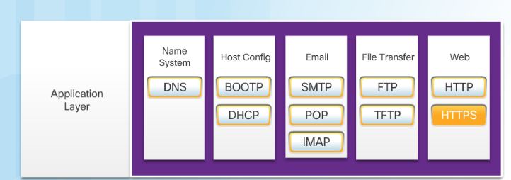
Application, Presentation, and Session TCP/IP Application Layer Protocols
Post Office Protocol (POP) TCP 110 - Enables clients to retrieve email from a mail server.
Internet Message Access Protocol (IMAP) TCP 143 - Enables clients to retrieve email from a mail server, maintains email on server.
File Transfer Protocol (FTP) TCP 20 and 21 - Reliable, connection-oriented, and acknowledged file delivery protocol.
Trivial File Transfer Protocol (TFTP) UDP 69 – simple connectionless file transfer protocol.
Hypertext Transfer Protocol (HTTP) TCP 80, 8080 - Set of rules for exchanging text, graphic images, etc. on the World Wide Web.
Hypertext Transfer Protocol Secure (HTTPS) TCP, UDP 443 – Uses encryption and authentication to secure communication.
Domain Name Server (DNS) TCP,UDP 53 - Translates domain names, such as cisco.com, into IP addresses.
(BOOTP) – Bootstrap Protocol - BOOTP is being superseded by DHCP.
Dynamic Host Configuration Protocol (DHCP) UDP client 68, server 67 – Dynamically assigns IP addresses to client stations at start-up.
Simple Mail Transport Protocol (SMTP) TCP 25 - Enables clients to send email to a mail server.
Notes:
10.1 – Application Layer Protocols
10.1.1 – Application, Presentation, and Session
10.1.1.3– TCP/IP Application Layer Protocols

Slide 18
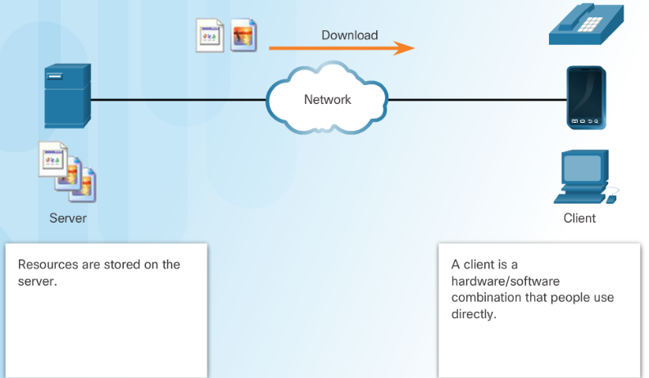
How Application Protocols Interact with End-User Applications Client-Server Model
Client and server processes are considered to be in the application layer.
Application layer protocols describe the format of the requests and responses between clients and servers.
Example of a client-server network is using an ISP’s email service to send, receive and store email.
Notes:
10.1 – Application Layer Protocols
10.1.2 – How Application Protocols Interact with End-User Applications
10.1.2.1– Client-Server Model

Slide 19
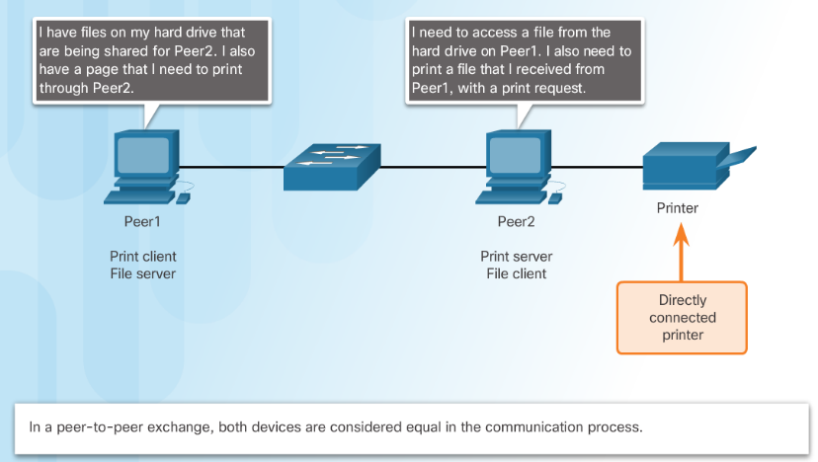
How Application Protocols Interact with End-User Applications Peer-to-Peer Networks
Data is accessed from a peer device without the use of a dedicated server.
Each device (known as a peer) can function as both a server and a client.
Notes:
10.1 – Application Layer Protocols
10.1.2 – How Application Protocols Interact with End-User Applications
10.1.2.2– Peer-to-Peer Networks

Slide 20
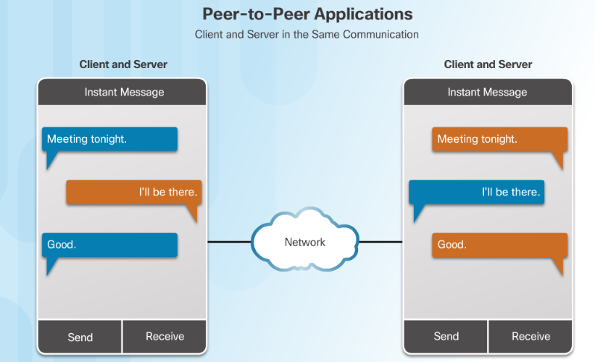
How Application Protocols Interact with End-User Applications Peer-to-Peer Applications
A P2P application allows a device to act as both a client and a server within the same communication.
P2P applications require that each end device provide a user interface and run a background service.
Notes:
10.1 – Application Layer Protocols
10.1.2 – How Application Protocols Interact with End-User Applications
10.1.2.3 – Peer-to-Peer Applications

Slide 21
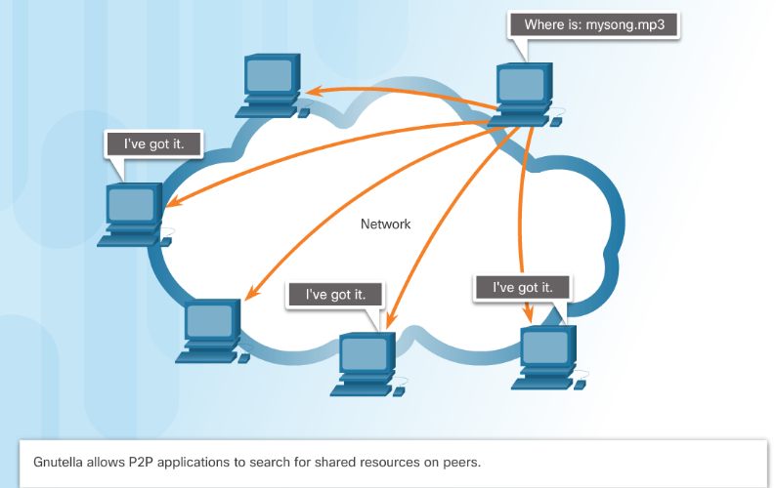
How Application Protocols Interact with End-User Applications Common P2P Applications
Common P2P networks include:
G2
Bitcoin
BitTorrent
eDonkey
Some P2P applications are based on the Gnutella protocol, where each user shares whole files with other users.
Many P2P applications allow users to share pieces of many files with each other at the same time –this is BitTorrent technology.
Notes:
10.1 – Application Layer Protocols
10.1.2 – How Application Protocols Interact with End-User Applications
10.1.2.4 – Common P2P Applications

Slide 22
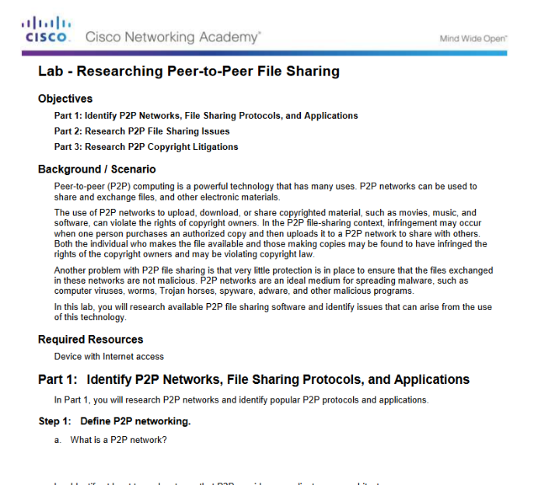
How Application Protocols Interact with End-User Applications Researching Peer-to-Peer File Sharing
Notes:
10.1 – Application Layer Protocols
10.1.2 – How Application Protocols Interact with End-User Applications
10.1.2.5 – Lab – Researching Peer-to-Peer File Sharing

Slide 23
10.2 Well-Known Application Layer Protocols and Services
Notes:
10 – Application Layer
10.2 Well-Known Application Layer Protocols and Services

Slide 24
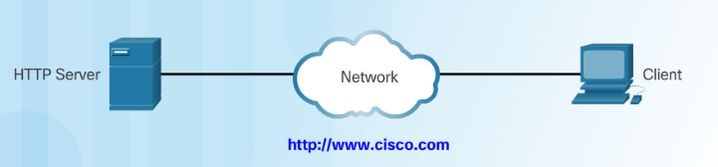
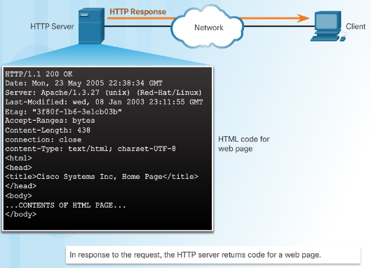
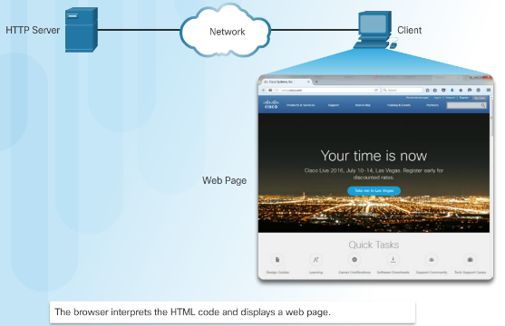
Web and Email Protocols Hypertext Transfer Protocol and Hypertext Markup Language
When a web address or uniform resource locator (URL) is typed into a web browser, the web browser establishes a connection to the web service running on the server, using the HTTP protocol.
Notes:
10.2 – Well-Known Application Layer Protocols and Services
10.2.1 – Web and Email Protocols
10.2.1.1 – Hypertext Transfer Protocol and Hypertext Markup Language

Slide 25
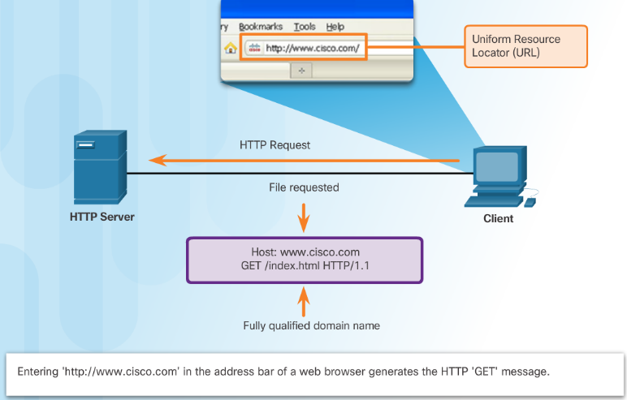
Web and Email Protocols HTTP and HTTPS
HTTP is a request/response protocol.
Three common HTTP message types are:
GET - A client request for data.
POST - Uploads data files to the web server.
PUT - Uploads resources or content to the web server.
HTTP Secure (HTTPS) protocol uses encryption and authentication to secure data.
Notes:
10.2 – Well-Known Application Layer Protocols and Services
10.2.1 – Web and Email Protocols
10.2.1.2 – HTTP and HTTPS

Slide 26
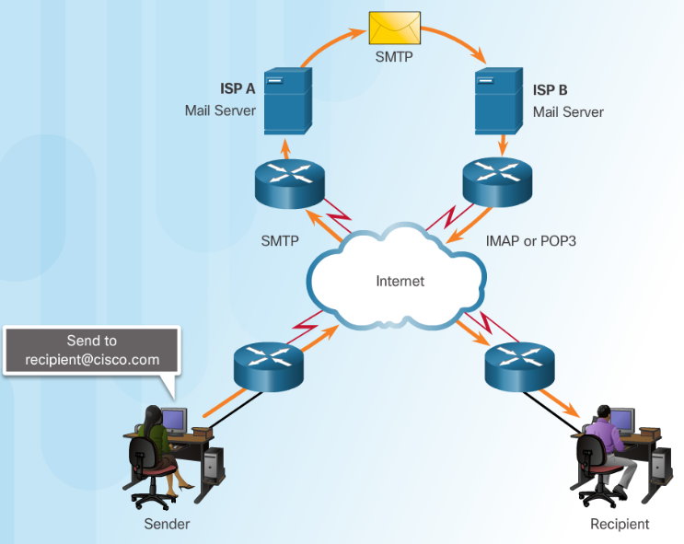
Web and Email Protocols Email Protocols
Email clients communicate with mail servers to send and receive email.
Mail servers communicate with other mail servers to transport messages from one domain to another.
Three protocols for email:
Simple Mail Transfer Protocol (SMTP) to send email.
Post Office Protocol (POP) to retrieve email.
Internet Message Access Protocol (IMAP) to retrieve email.
Notes:
10.2 – Well-Known Application Layer Protocols and Services
10.2.1 – Web and Email Protocols
10.2.1.3 – Email Protocols

Slide 27
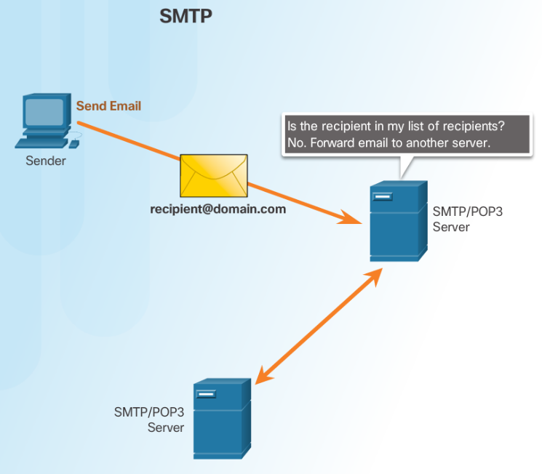
Web and Email Protocols SMTP Operation
SMTP is used to send email
Notes:
10.2 – Well-Known Application Layer Protocols and Services
10.2.1 – Web and Email Protocols
10.2.1.4 – SMTP Operation

Slide 28
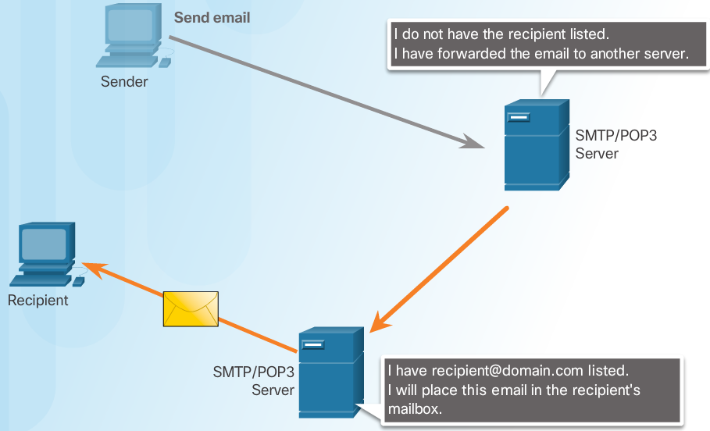
Web and Email Protocols POP Operation
POP is used to retrieve email from a mail server.
Email is downloaded from the server to the client and then deleted on the server.
Notes:
10.2 – Well-Known Application Layer Protocols and Services
10.2.1 – Web and Email Protocols
10.2.1.5– POP Operation

Slide 29
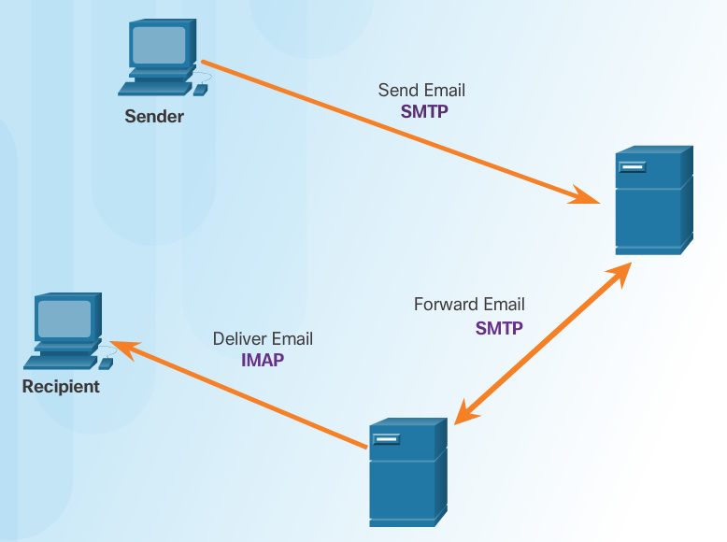
Web and Email Protocols IMAP Operation
IMAP is used to retrieve mail from a mail server.
Copies of messages are downloaded from the server to the client and the original messages are stored on the server.
Notes:
10.2 – Well-Known Application Layer Protocols and Services
10.2.1 – Web and Email Protocols
10.2.1.6 – IMAP Operation

Slide 30
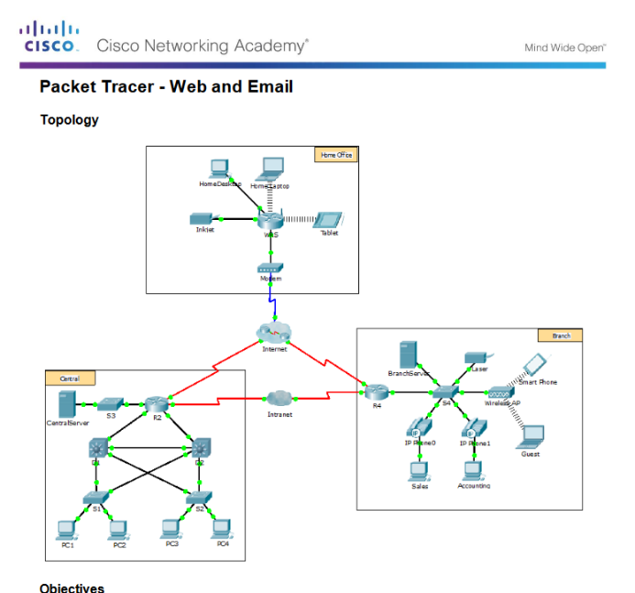
Web and Email Protocols Packet Tracer – Web and Email
Notes:
10.2 – Well-Known Application Layer Protocols and Services
10.2.1 – Web and Email Protocols
10.2.1.7 – Packet Tracer – Web and Email

Slide 31
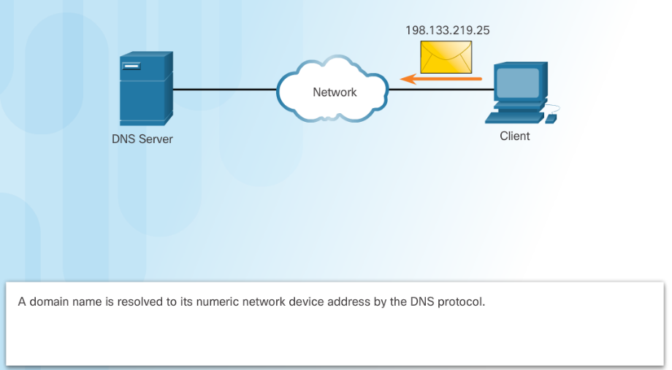
IP Addressing Services Domain Name Service
Domain names convert the numeric address into a simple, recognizable name.
The DNS protocol defines an automated service that matches resource names with the required numeric network address.
Notes:
10.2 – Well-Known Application Layer Protocols and Services
10.2.2 – IP Addressing Services
10.2.2.1 – Domain Name Service

Slide 32
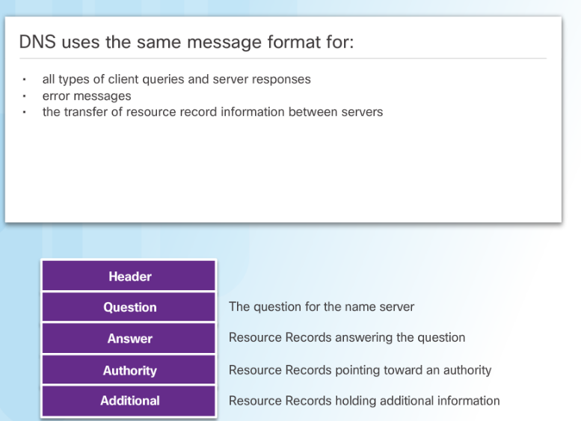
IP Addressing Services DNS Message Format
When a client makes a query, the server’s DNS process first looks at its own records to resolve the name.
If unable to resolve, it contacts other servers to resolve the name.
The server temporarily stores the numbered address in the event that the same name is requested again.
The ipconfig /displaydns command displays all of the cached DNS entries on a Windows PC.
Notes:
10.2 – Well-Known Application Layer Protocols and Services
10.2.2 – IP Addressing Services
10.2.2.2 – DNS Message Format

Slide 33
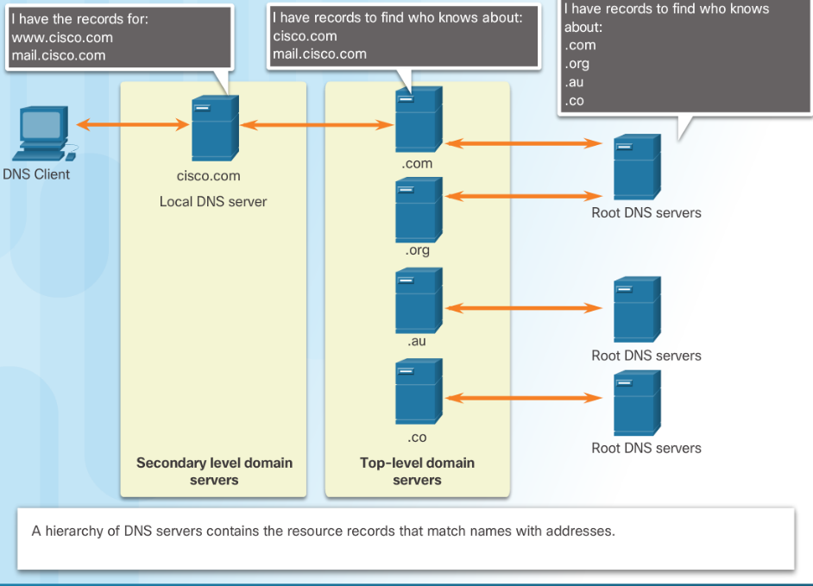
IP Addressing Services DNS Hierarchy
Notes:
10.2 – Well-Known Application Layer Protocols and Services
10.2.2 – IP Addressing Services
10.2.2.3 – DNS Hierarchy

Slide 34
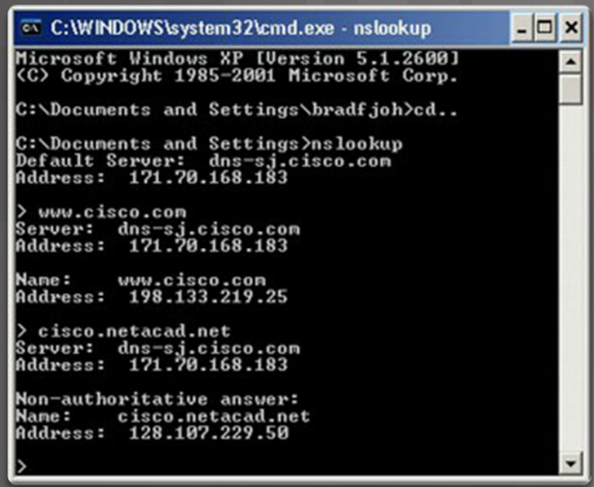
IP Addressing Services The nslookup Command
Nslookup - a utility that allows a user to manually query the name servers to resolve a given host.
Can also be used to troubleshoot name resolution issues and to verify the current status of the name servers.
Notes:
10.2 – Well-Known Application Layer Protocols and Services
10.2.2 – IP Addressing Services
10.2.2.4 – The nslookup Command

Slide 35
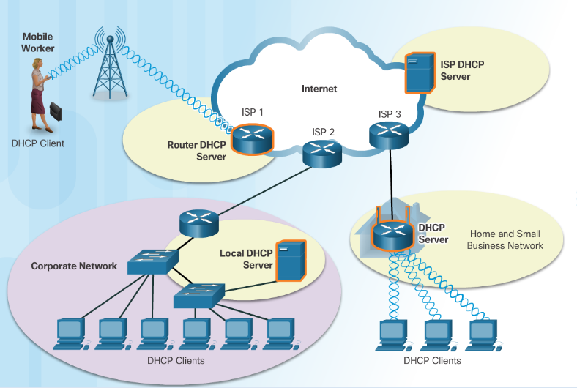
IP Addressing Services Dynamic Host Configuration Protocol
The Dynamic Host Configuration Protocol (DHCP) for IPv4 automates the assignment of IPv4 addresses, subnet masks, gateways, and other parameters.
DHCP-distributed addresses are leased for a set period of time, then returned to pool for reuse.
DHCP is usually employed for end user devices. Static addressing is used for network devices, such as gateways, switches, servers, and printers.
DHCPv6 (DHCP for IPv6) provides similar services for IPv6 clients.
Notes:
10.2 – Well-Known Application Layer Protocols and Services
10.2.2 – IP Addressing Services
10.2.2.5 – Dynamic Host Configuration Protocol

Slide 36
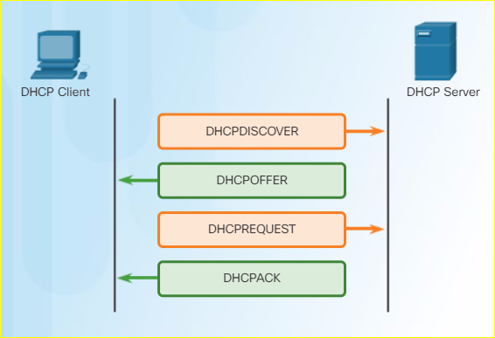
IP Addressing Services DHCP Operation
Notes:
10.2 – Well-Known Application Layer Protocols and Services
10.2.2 – IP Addressing Services
10.2.2.6 – DHCP Operation

Slide 37
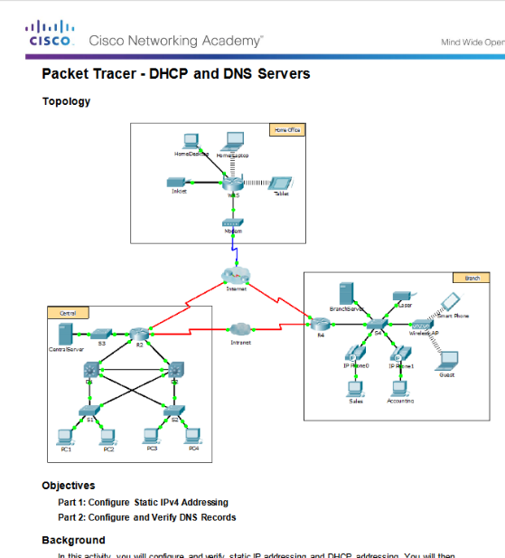
IP Addressing Services Packet Tracer – DHCP and DNS Servers
Notes:
10.2 – Well-Known Application Layer Protocols and Services
10.2.2 – IP Addressing Services
10.2.2.7 – Packet Tracer – DHCP and DNS Servers

Slide 38
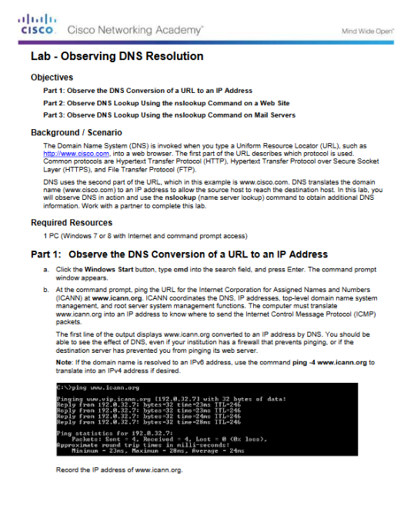
IP Addressing Services Lab – Observing DNS Resolution
Notes:
10.2 – Well-Known Application Layer Protocols and Services
10.2.2 – IP Addressing Services
10.2.2.8 – Lab – Observing DNS Resolution

Slide 39
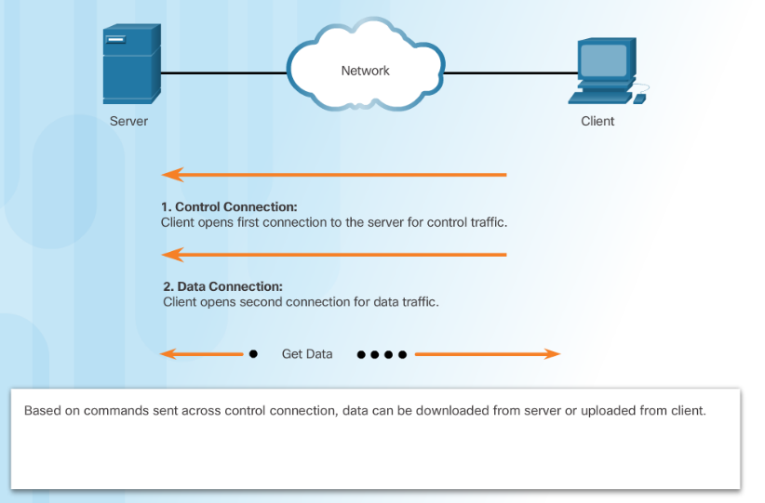
File Sharing Services File Transfer Protocol
FTP requires two connections between the client and the server, one for commands and replies, the other for the actual file transfer:
The client establishes the first connection to the server for control traffic using TCP port 21.
The client establishes the second connection to the server for the actual data transfer using TCP port 20.
Notes:
10.2 – Well-Known Application Layer Protocols and Services
10.2.3 – File Sharing Services
10.2.3.1 – File Transfer Protocol

Slide 40
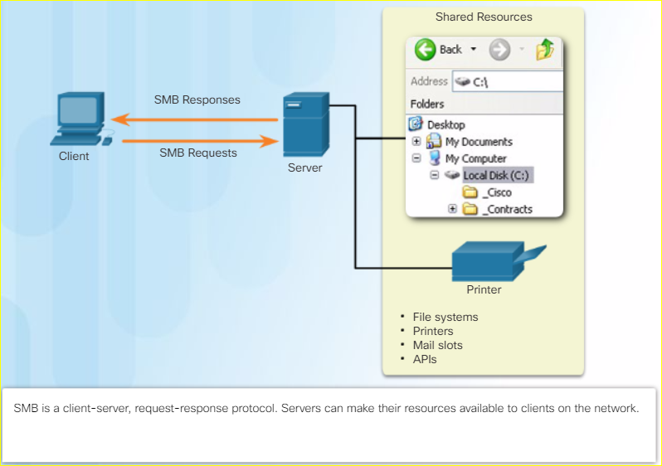
File Sharing Services Server Message Block
The Server Message Block (SMB) is a client/server file sharing protocol:
SMB file-sharing and print services have become the mainstay of Microsoft networking.
Clients establish a long-term connection to servers and can access the resources on the server as if the resource is local to the client host.
Notes:
10.2 – Well-Known Application Layer Protocols and Services
10.2.3 – File Sharing Services
10.2.3.2 – Server Message Block

Slide 41
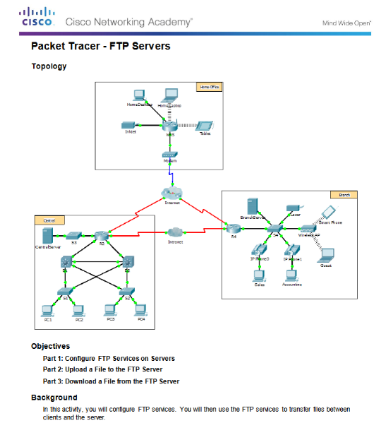
File Sharing Services Packet Tracer - FTP
Notes:
10.2 – Well-Known Application Layer Protocols and Services
10.2.3 – File Sharing Services
10.2.3.3 – Packet Tracer - FTP

Slide 42
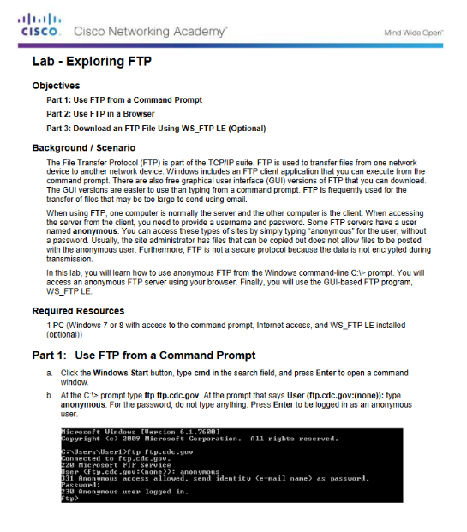
File Sharing Services Lab – Exploring FTP
Notes:
10.2 – Well-Known Application Layer Protocols and Services
10.2.3 – File Sharing Services
10.2.3.4 – Lab – Exploring FTP

Slide 43
10.3 Summary
Notes:
10 – Application Layer
10.3 Summary

Slide 44
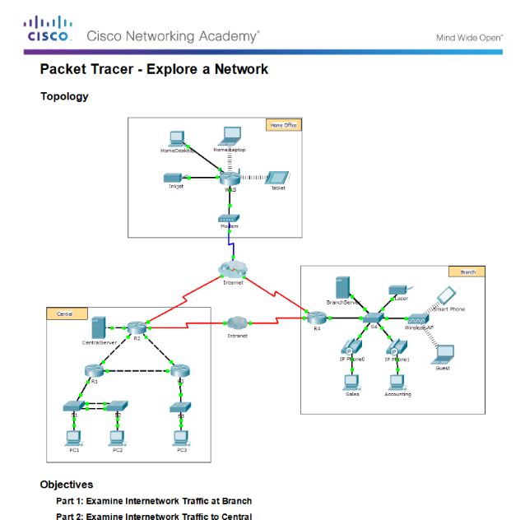
Conclusion Packet Tracer - Explore a Network
Notes:
10.3 – Summary
10.3.1 – Conclusion
10.3.1.2 – Packet Tracer - Explore a Network

Slide 45
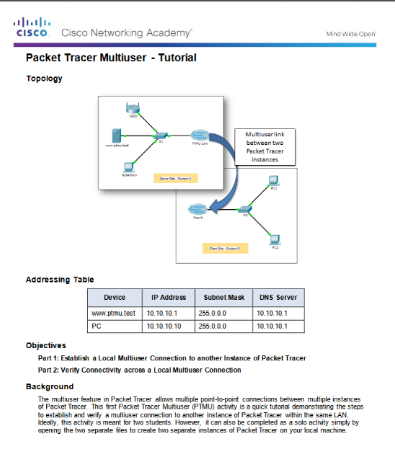
Conclusion Packet Tracer - Multiuser - Tutorial
Notes:
10.3 – Summary
10.3.1 – Conclusion
10.3.1.3 – Packet Tracer - Multiuser - Tutorial

Slide 46
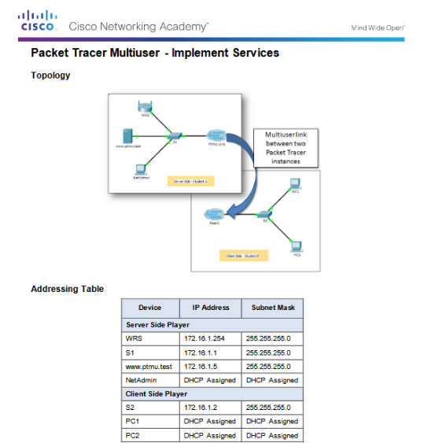
Conclusion Packet Tracer Multiuser - Implement Services
Notes:
10.3 – Summary
10.3.1 – Conclusion
10.3.1.4 – Packet Tracer Multiuser - Implement Services

Slide 47
Conclusion Chapter 10: Application Layer
Explain the operation of the application layer in providing support to end-user applications.
Explain how well-known TCP/IP application layer protocols operate.
Notes:
10.3 – Summary
10.3.1 – Conclusion
10.3.1.4 – Chapter 10: Application Layer

Slide 48
Chapter 10 New Terms and Commands
Bootstrap Protocol (BOOTP)
Simple Mail Transfer Protocol (SMTP)
Post Office Protocol (POP)
Internet Message Access Protocol (IMAP)
File Transfer Protocol (FTP)
Trivial File Transfer Protocol (TFTP)
client-server
Server Message Block (SMB)
Notes:
New Terms and Commands

